Slide 1
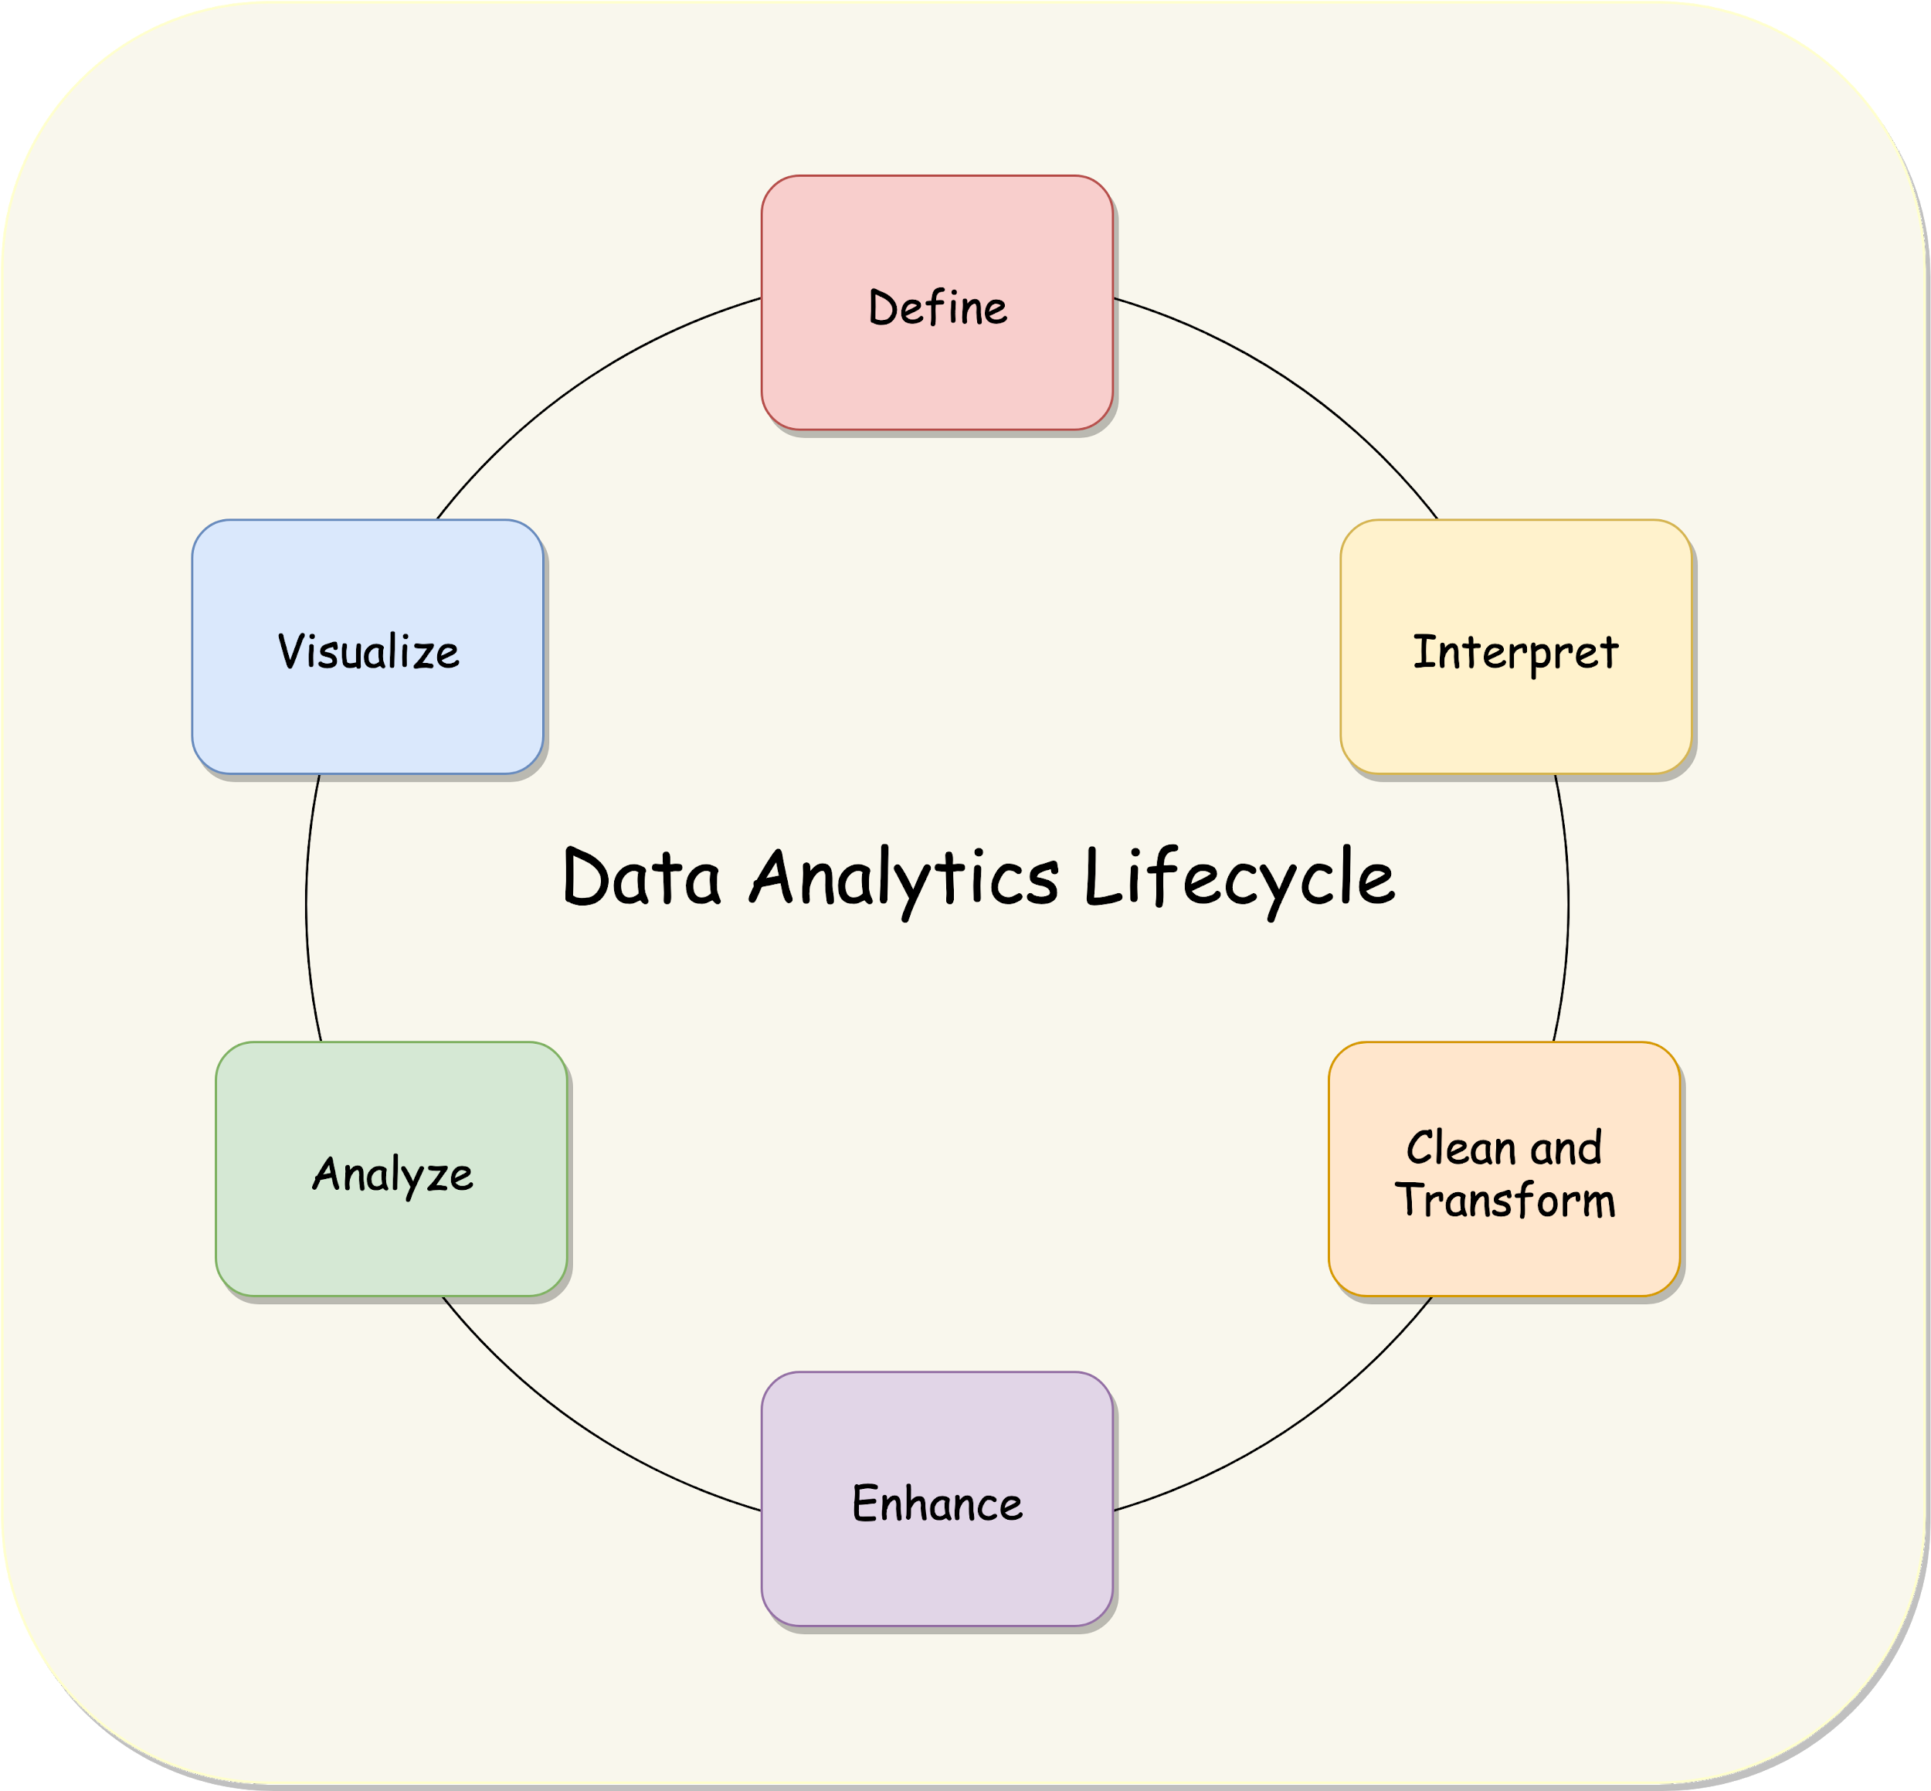

AWS Data Analytics - Introduction to Data Collection Systems
Data Analytics Lifecycle

Slide 2
AWS Data Analytics - Introduction to Data Collection Systems
Introduction - Stages of Data Collection
Determine the operational characteristics of the collection system
Streaming operational components
Fault tolerance and data persistence
Select a collection system that handles the frequency, volume, and source of data
Batch, streaming, and transactional data
Compare data collection systems
Select a collection system that addresses the key properties of data, such as order, format, and compression
Order and duplication
Transformation and filtering

Slide 3
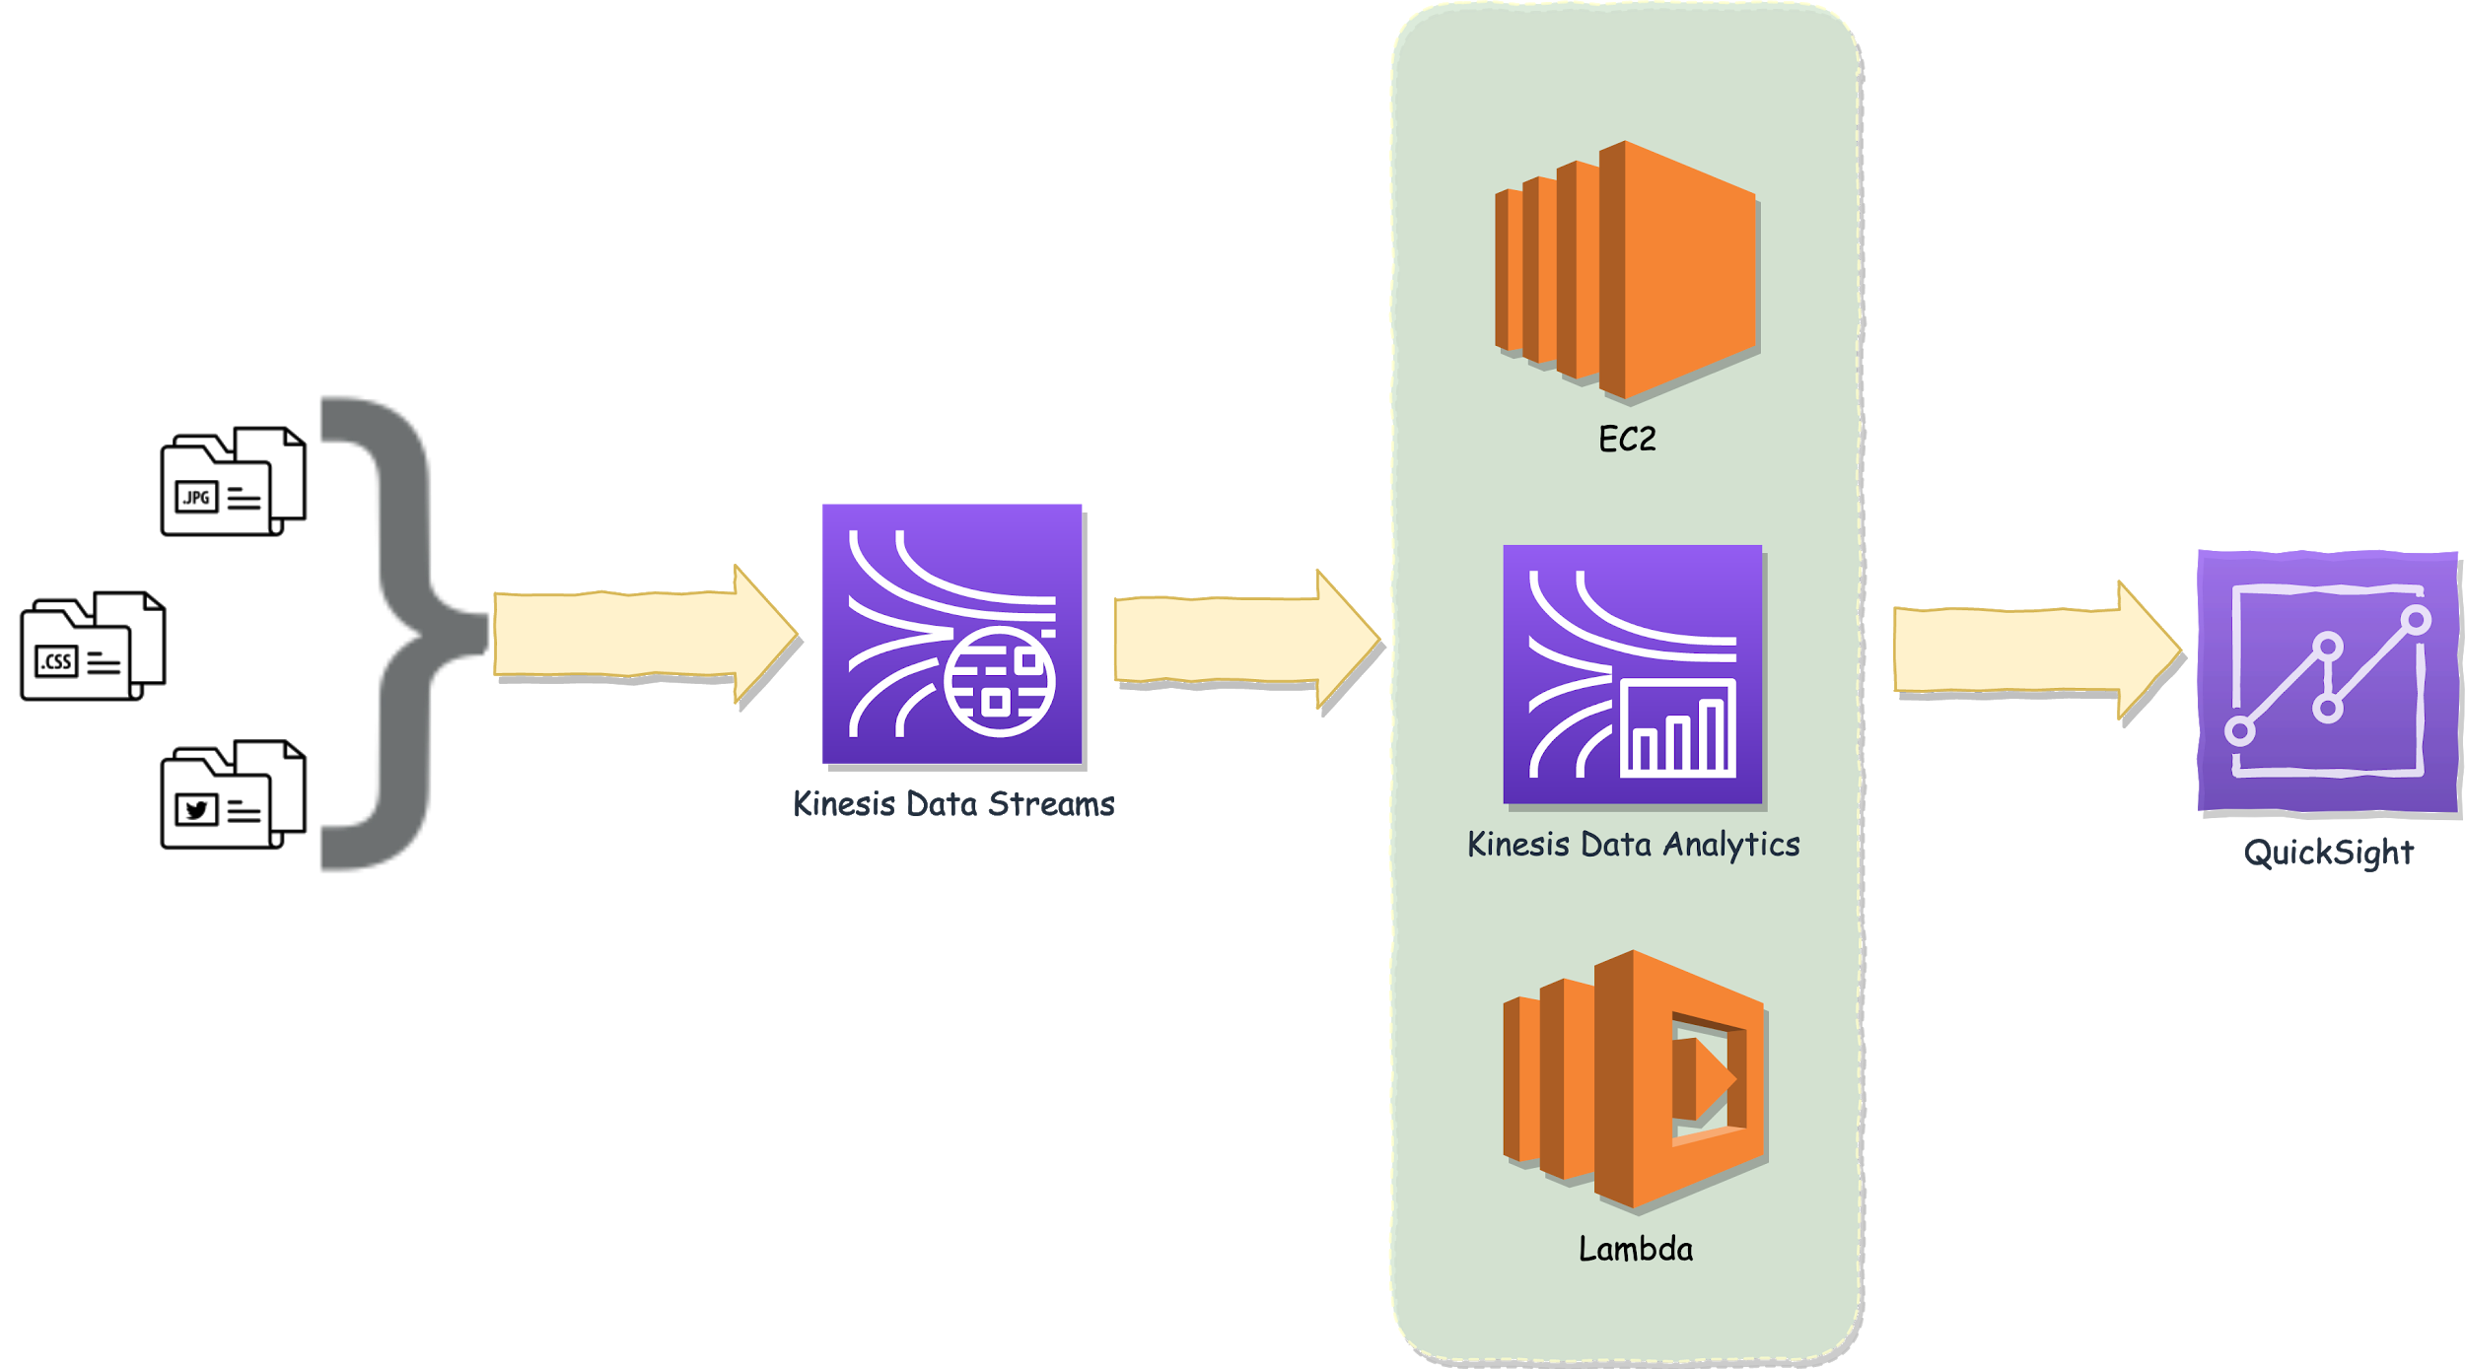
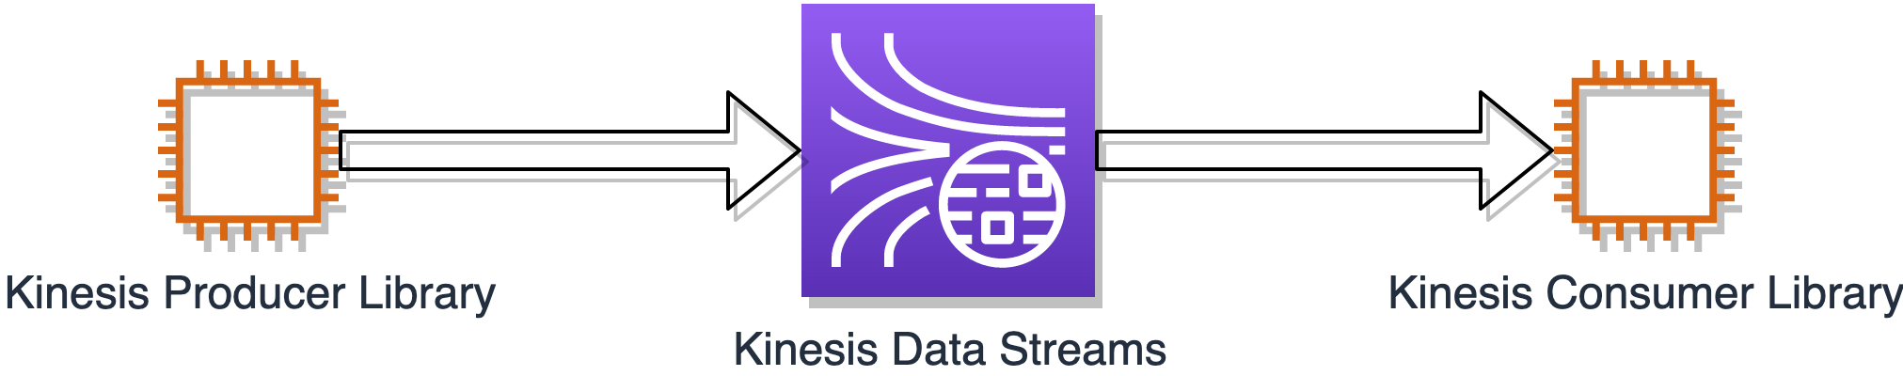
AWS Data Analytics - Introduction to Data Collection Systems
Introduction - Determine the operational characteristics of the collection system
Determine the operational characteristics of the collection system
Streaming operational components
Fault tolerance and data persistence

Slide 4
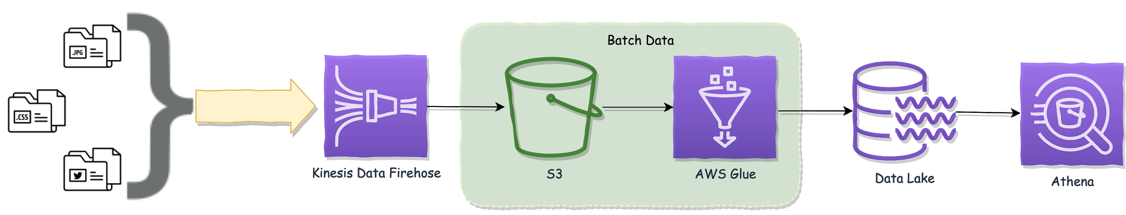
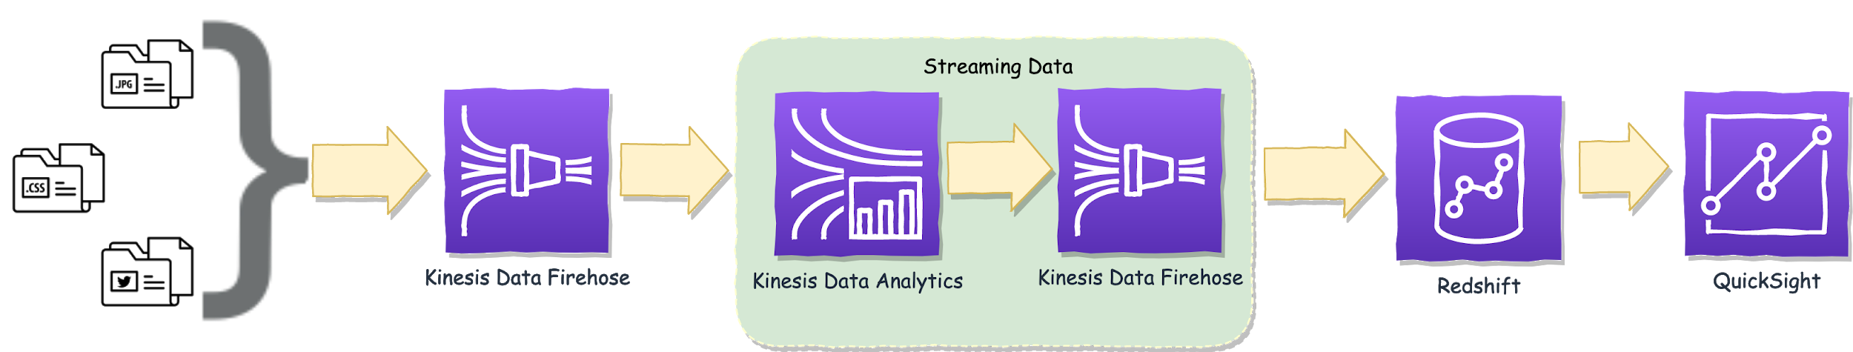
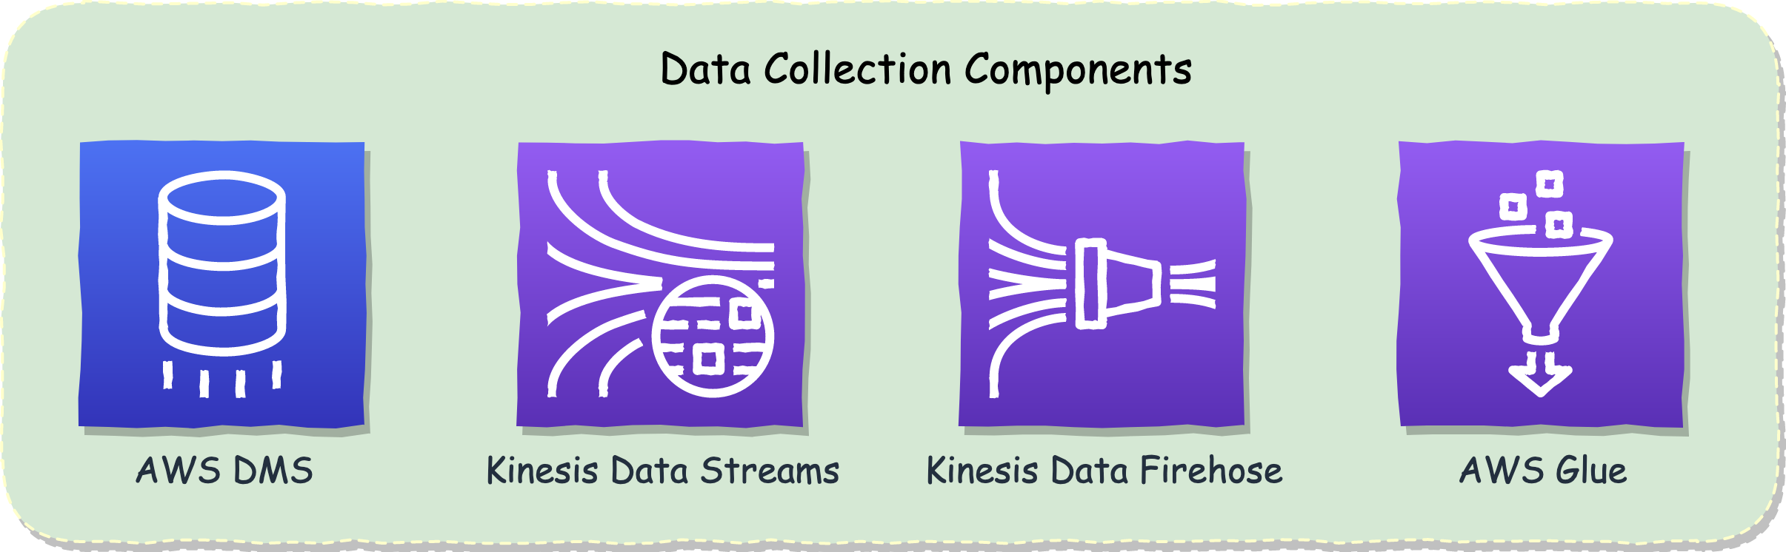
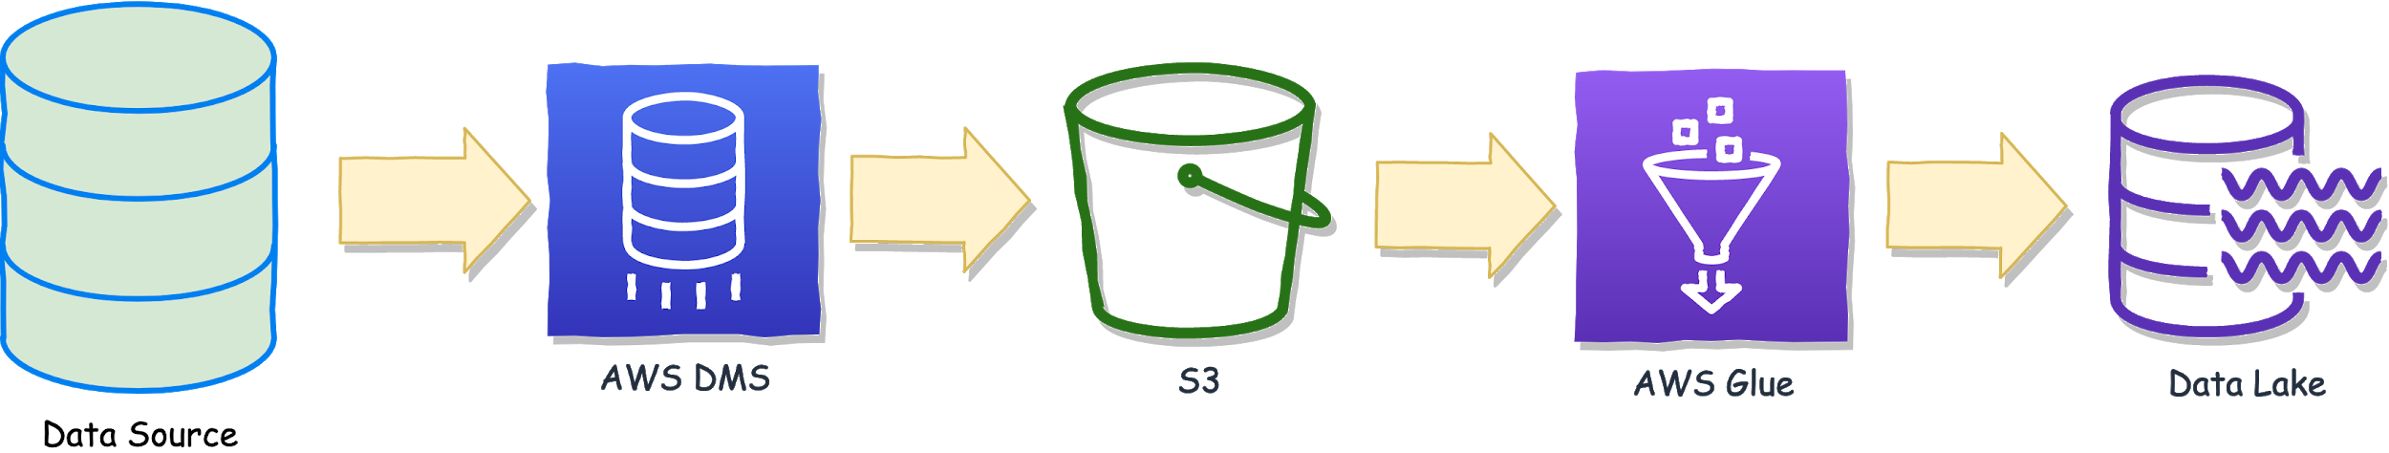
AWS Data Analytics - Introduction to Data Collection Systems
Introduction - Select a collection system that handles the frequency, volume, and source of data
Select a collection system that handles the frequency, volume, and source of data
Batch, streaming, and transactional data
Compare data collection systems

Slide 5
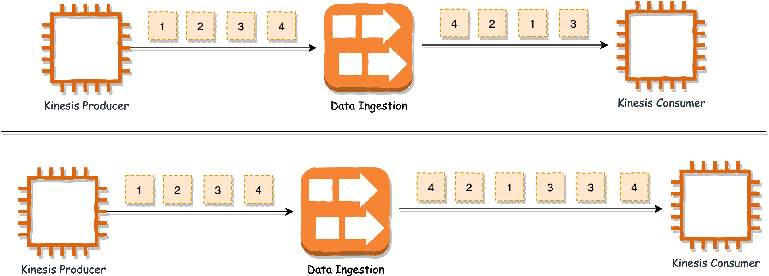
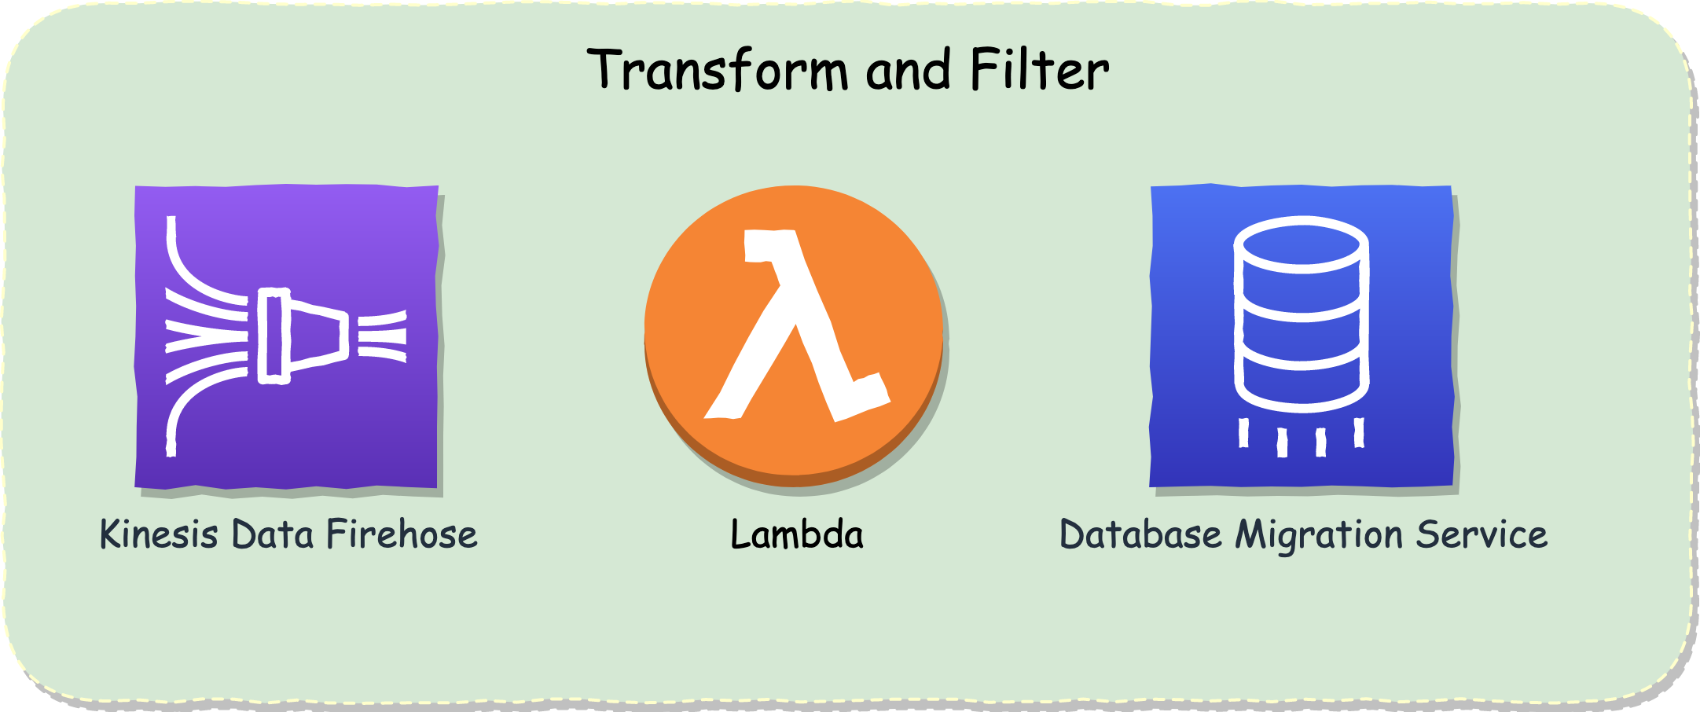
AWS Data Analytics - Introduction to Data Collection Systems
Introduction - Select a collection system that addresses the key properties of data, such as order, format, and compression
Select a collection system that addresses the key properties of data, such as order, format, and compression
Order and duplication
Transformation and filtering

Slide 6
AWS Data Analytics - Introduction to Data Collection Systems
Summary
Data collection systems give you the capability to ingest any kind of data, structured, unstructured, or semi-structured
Can ingest using the appropriate frequency based on your situation
Batch
Streaming
Transactional
Transform and/or filter your data as you collect it

